Slide 1
1281 Design Rule Overview
Monday, April 6, 2026
Disclaimer: Rule definition for X81A is in progress. These rules are NOT FINAL.

Slide 2
1281 vs 1280: Frontside Power Delivery
P1280 power delivery method is emr, where power is delivered from the backside bump through backside metal/via layers through emr to the transistor.
P1281 has no backside. Bumps are on the frontside. P1281 power is delivered from the frontside bump through frontside metal/via layers to M0 to VCR to VCRnub to the transistor
1280
1281
Top-down
Cross-section
Top-down
Cross-section
tcn
poly
emr
VCR
nub
tcn
tcn
bm0
tcn
poly
VCR
diffusion
tcn
emr
diffusion
TCN not shown for clarity
bm0

Slide 3
Deltas with respect to 1280
Drawn dimension | 1280 (nm) | 1281 (nm)
Poly Pitch | 48 | 44
Cell Height (PGD) | 288, 144, 126, 108 | 165, 132, 110
Poly width | 14 | 12
tcn width | 14 | 12
Poly length, max | 562 | up to 4CH for some use cases in digital
poly ETE , fixed | 18 | 14
tcn length, max | 2CH | up to 2CH for some use cases
tcn ETE, fixed [CRL, DKA] | 18 except for depop | 16, 32 (DKA,CRL) except for depop
Power supply to transistor | Backside power grid - emr | Frontside power grid - vcr
NN/PP space, min (drawn) | 22 | 20
Diffusion Alignment | center aligned | center aligned
CH: cell height
1281 Design Rule Overview_01202026.pptx (page 3)

Slide 4
Basetransition and region construction
Etch Ring (ER)
EOA
Edge of die Monitor (EDM)
BT
BT
BaseRegion (2*132nm)
BT
Active Design Area
OGD_halo
1281 removes whitespace between regions and uses a new layer called basetranition;id (BT)
Region PGD edges must abut BT to transition in OGD
BT has strict construction rules on where the BT OGD edges can be placed, and BT spacing rules.
der
BaseRegion
OGD_halo
OGD_halo
BaseRegion
BT
BaseRegion (2*110nm)
BT
OGD_halo
OGD_halo
BT
der
BT
der
BaseRegion
Region 2 Region (PGD)
=0 Or >=55nm+11*N (N>=0)
OGD_halo
OGD_halo
OGD_halo
der
OGD_halo
der
BT
OGD_halo
der
BT
der
BT
?
BT
OGD_halo
BT
BaseRegion
BT
BaseRegion
(2*165)
der
BaseRegion
BT
OGD_halo
OGD_halo
OGD_halo
OGD_halo
Region2Region (OGD)
=3pp Or >=27pp+88*N (N>=0)
BT
OGD_halo
OGD_halo
OGD_halo
OGD_halo
der

Slide 5
Base & Context ID names
Base Region layers designate cell height regions with associated allowances based on design need
Context layers and derived layers with base region allowance
 | Digital context for APR construction | Custom context for custom digital and custom analog | Memory context for memory periphery are derived using memory block construction | Memory SDR bitcell context is not planned for X81A
110CH | digital;id | N/A | N/A | N/A
132CH | digital;id | custom;id | MemoryRegionID | N/A
165CH | digital;id | custom;id | N/A | N/A
Memory columns | N/A | N/A | MemoryColumnContextID | N/A
 | Base Region ID layers
110CH | b110h_44ppBaseRegion;id
132CH | b132h_44ppBaseRegion;id
165CH | b165h_44ppBaseRegion;id
digital;id
custom;id
Active content must exist inside a “context” which the user declares with an ID
The context IDs must be enclosed in a base region
Digital context and custom context are explicitly drawn by designer; while memory context is derived by runset
Example shows 3 contexts (1digital, 2 custom) inside base region
custom;id
B132h_44ppBaseRegion;id

Slide 6
Front-End Layer Rules

Slide 7
Key Layers
Layer | New to P1281? | Layer;purpose | Description
ndiff pdiff |  | 1;0 8;0 | Diffusion electrical connections. Two layers one for ntype devices and another for ptype devices. Supports both drawing (;0) and fill type (;250).
fin | Y | 12;0 | Fin layer representing nanoribbons. Supports only drawing type.
poly |  | 2;0 | polysilicon layer forming gate with diffusion. Supports both drawing (;0) and fill type (;250).
tcn |  | 15;0 | trench contact with epi. Supports both drawing (;0) and fill type (;250).
vcr | Y | 36;0 | via power rail. Wide rail to connect tcn to m0. Supports both drawing (;0) and fill type (;250).
vcrnub | Y | 510;0 | vcr connection to tcn. Supports both drawing (;0) and fill type (;250).
fti |  | 184;0 | lnr trim isolation layer. Supports both drawing (;0) and fill type (;250).
sdGen |  | 11;0 | Key layer for blocking masks. Supports only drawing type.
ctcn | Y | 66;0 | tcn plug layer. Supports only drawing type.
glk | Y | 65;0 | poly link layer. Supports only drawing type.
trm | Y | 509;0 | poly cut layer. Supports only drawing type.
*vt |  | Enumerate or add link | See device layer list for offering. In total 12 different vt’s are offered (6N + 6P)

Slide 8
Cell Height Region – a Primer
CRL
1x Cell Height
A cell height region generates two imaginary reference lines used in many of the DRs
  Cell Reference Line (CRL)
  Diffusion Keep-away Line (DKA)
CRL is located at every N*cell height
DKA is half-way between each pair of CRL
There are 3 cell heights used for Base Regions (110, 132, 165) and 3 more cell heights specific to memory columns (114, 126, 128)
Diffusion sizes for each cell height are here
DKA
CRL
DKA
CRL
DKA
CRL
=cell height region

Slide 9
Cell Constructions - Ground Rules for Cells
Highly gridded fixed poly, tcn ETE constructions
P-P, N-N spaces is symmetric
Layer | Dimension (nm)
poly length [PGD], min | 41
poly ETE [PGD], fixed | 14
poly width [OGD], fixed | 12
poly pitch [OGD], fixed | 44
tcn length [PGD], min | 27
tcn width [OGD], fixed | 12
tcn ETE [PGD], fixed | 16, 32
vcr width [PGD], fixed | 12
vcrnub [PGD], fixed | 8.4, 16.8 or 2x8.4, 2x16.8
trm [PGD], fixed | 14
Diffusion space [PGD], min | 20
CRL to diff OGD edge [PGD], min | 10
=12
=14
CRL
>= 10
Cell
Height
=12
=12
diff center line
>= 20
=14
=16
DKA
diff center line
=8.4
CRL
=7
TRM is a new drawn layer that cuts poly and tcn. More info here:
poly
VCR
vcrnub
tcn
ctcn
diffusion
fin
TRM
GLK

Slide 10
Diffusion Design Rules
Up to 4 diffusion widths supported per given region
3 Types of Turbo cells are provided
Diffusions are center-aligned with respect to Diff center line
Diff width | Z low | Z mid-low | Z mid-high | Z high | MaxLNR | Balanced cell | OPH
165 CH | 31 | 40 | 52 | 62 | N/a | N/a | N/a
132 CH | 31 | 35 | 40 | 46 | N/a | N/a | 72
110 CH | 27 | 31 | 35 | N/a | 72 | 72/40 | N/a
132h (Z mid-high)
132h (Z mid-low)
40
35
Diff center line
=diff
DKA
* exceptions:
2) CE! Bitcell collaterals do not have reference lines defined

Slide 11
fin_jog Design Rules
=tcn
Gate OGD separation depends on the PGD size difference between the transitioning fins
Not applicable to Turbo cells: turbo cells have natural line ends which have a different set of rules
=fti
=fin
=poly
=diff
Active 1 poly pitch from fin_jog allowed when fin_jog is <= 12nm
Active 1.5 poly pitch from fin_jog allowed when 12nm < fin_jog <= 24nm
Active 2 poly pitch from fin_jog allowed when fin_jog is > 24nm
active
active
active
active
active
active
1 poly pitch allowed
60nm and greater allowed
82nm and greater allowed

Slide 12
Fin and diffusion Design Rules
fin must be fully populated except for specific exceptions. Only allowed in turbo cells, basetransition (BT) and special fixed collateral.
fin depop (aka. DNU) is not allowed
X
Poly track
fin
DNU
X
CRL

Slide 13
TRM Rules
TRM is a new drawn layer: CAD representation of poly cut.
TRM is highly gridded and is drawn as a continuous polygon placed at the CRL, DKA or PCT
TRM is placed at CRL and DKA for all cells except turbo cells
To connect poly between different half cells, poly is extended over trm and glk is drawn at the intersection
CRL
Cell
Height
7nm
14 nm
DKA
CRL
poly
trm
glk

Slide 14
Poly Restrictions
General poly length must be under 2 cell height
poly;drawing must not cross CRL if there is an sdGen edge at that CRL
poly;drawing must not cross CRL if there is a vt change at that CRL
Maximum number of consecutive poly with maximum length must be less than 2
X
O
X
O
poly;drawing
CRL
DKA
SDGEN
NSVT
NSVT
NLVT
NLVT
PSVT
O
O
X
DRV
NSVT
X
O
O
O
DR clean
Both are SVT
Poly parallel run length > 2ch
PSVT

Slide 15
TRM Rules
Region ID edge must be coincident on TRM
>= 220 nm min space between TRM
TRM PGD edge ends on BT at logicchRegionID edge
TRM OGD edge straddles the OGD edge of the Region
BT
TRM
>=220nm
>=220nm
logicchRegionID

Slide 16
TRM Rules
Poly OGD edge must abut TRM
FTI OGD edge must abut TRM center
TRM PGD edges must be coincident with global_tcn_grid. Exception:
  When TRM PGD edge abuts BT
General
BT
X
TRM
X
X
X
X
Allowed for BT abutment
poly
global_tcn_grid
FTI
X
global_poly_grid

Slide 17
TCN Design Rule
tcn has a fixed width: 12nm
tcn has a fixed ETE size under 40nm: 16nm or 32nm
tcn must not interact two or more vt devices
tcn;drawing must not cross CRL if there is a change in devflav at that CRL
X
O
O
X
O
CRL
tcn;drawing
PSVT
NSVT
DKA
NSVT
NSVT
Both are SVT
NSVT
NLVT
NLVT
NSVT
NSVT
NLVT
PSVT
PSVT
PLVT
PLVT
X
DRV
O
DR clean

Slide 18
VCR and VCRNUB Design Rule
VCR is a contact rail delivering power/ground
VCR is drawn at the cell boundary along the CRL
VCRNUB is an independent CAD layer that is merged with VCR for manufacturing
tcn can only connect to a VCR if overlapping vcrnub
VCR
VCR
poly
VCR
vcrnub
tcn
diffusion
*some layers not shown for simplicity

Slide 19
VCR and VCRNUB Design Rules
=vcr
=vcrnub
VCR
>=88 nm
=12 nm
110 cell height
132, 165 cell height
=16.8 nm
=26.8 nm
=8.4 nm
=13.4 nm

Slide 20
Stacked FTI Restriction
Stacked FTI is legal
3 consecutive stacked FTI is illegal. Unique exceptions for transitions may apply.
Any active transistor inside logicchRegionID must be semi-nested or fully nested. Special allowances granted for X81A with ID for isolated devices.
X
X
Diff;drawing
FTI
Active Gate
Inactive Gate

Slide 21
Current - Vt ID Design Rules
vt ID min dimension is 10PP x 1 cell height
PGD
Description | Spec
OGD space | 450 (10xPP)
PGD & diagonal space | 48
Length [OGD] | 450 (10xPP)
Segment L [OGD] | 45 (1xPP)
Segment L [PGD] | 48
Internal C2C [PGD and diagonal] | 48
C2C width/space if aligned external corners [OGD] | 48
C2C width/space if aligned external corners [PGD] | 48
vtID internal corner space to gate, minimum [diagonal] | 48
vtID enclosure of gate, minimum | 8 (PGD) 84 (OGD)
poly tracks
= 10 x PP
OGD
CRL
dka
Half cell height
CRL
Half cell height
dka
1 x PP
1PP
CRL
Half cell height
dka
Half cell height
Half cell height
1 x PP
CRL
Half cell height
dka
10xPP
CRL
10 x PP
Vt ID

Slide 22
Current - Vt ID Design Rules – Cont’d
PGD pitch of 1.5 x cell height required
No vt transition at DKA (other than nlvt-plvt, nsvt-psvt)
Description | Spec
segment length between 2 point-touch corners, minimum [PGD and OGD] | 96
Min. devflavID pitch | 144
CRL
dka
CRL
dka
CRL
PGD pitch
1.5 x cell height
2-point touch corner
dka
Half cell height
CRL
1 x cell height
nlvt
nlvt
dka
psvt
plvt
dka
Vt ID

Slide 23
Drawn Tap Ids/ Usages in X81A
Tap ID name | Tap Type | Usage Goal | DBI Mask | PDK offering
pdiff;tapID | ptapA | LU | Closed | N
ndiff;tapID | ntapA | LU | Closed | N
pdiff;tapID (inside Memory_block) | ptapB1 | LU | Closed | N
ndiff;tapID in (inside Memory_block) | ntapB | LU | Closed | N
pid;tapID (inside HaloID) | ptapB2 | PID | Open | Y
pid;tapID (inside active design) | ptapB1 | PID | Open | Y
ndiffHV;tapID | ntapB | ISO BD | Open | Y
These will be the full list of ids and occurrences in X81A
Designers own correctly marking the taps to get substrate connection

Slide 24
Drawn Tap Styles in X81A (NOM CMOS area)
Fin
5PP
7PP
7PP
Sdgen
ndiff
ptapB1 (Memorybit/col LU)
ptapB2 (Halo pidTap)
pdiff
ntapA (Logic LU)
Tap(Sdgen Jog)
Tap(NPtrans)
Tap(NPtrans)
Ntap
Ptap
5/7PP
7PP
epiblocking;id
ptapA (Logic LU (5PP), active pidTap (7PP))
ntapB ( Memorybit/Col LU)
Tap(SdGen Cut)
Tap(NPtrans)

Slide 25
tapID Width/ Max Tap-DiffSpace rules
VCR/nub
sdGen
,TAP_W_01,"{ndiff;tapID, hv;tapID, pdiff;tapID, pid;tapID} width, minimum [OGD]",>=,0.220,,"811",,
,TAP_W_02,"{ndiff;tapID, hv;tapID, pdiff;tapID, pid;tapID} width, minimum [PGD] :: exception: TAP_W_02_1",>=,0.132,,"811",,
,TAP_W_02_1,"{{ndiff;tapID, pdiff;tapID, pid;tapID} inside b110h_44ppBaseRegion;id} width, minimum [PGD]",>=,0.11,,"811",,
1CH
ndiff
5/7PP
pdiff
Ntap;id
Ptap;id
1CH
5/7PP
Tap to Diff Space
Area | Max Spcing
Logic | 10
RF_Block | 25
SRAM_Block | 25
HV/EHV | 10

Slide 26
Tap 2 tap Space rules
VCR/nub
,TAP_S_33,"{ndiff;tapID, hv;tapID, pdiff;tapID, pid;tapID} space to {ndiff;tapID, hv;tapID, pdiff;tapID, pid;tapID}, minimum [OGD]",>=,0.22,,"811",,
,TAP_S_02,"{ndiff;tapID, hv;tapID, pdiff;tapID, pid;tapID} space to {ndiff;tapID, hv;tapID, pdiff;tapID, pid;tapID}, minimum [PGD] :: exception: TAP_S_02_1",>=,0.132,,"811",,
,TAP_S_02_1,"{{ndiff;tapID, hv;tapID, pdiff;tapID, pid;tapID} inside b110h_44ppBaseRegion;id} space to {ndiff;tapID, hv;tapID, pdiff;tapID, pid;tapID}, minimum [PGD]",>=,0.11,,"811",,
,TAP_S_03,"{ndiff;tapID, hv;tapID, pdiff;tapID, pid;tapID} corner-to-corner space to {ndiff;tapID, hv;tapID, pdiff;tapID, pid;tapID}, minimum ## corner touch not allowed",>=,0.245,,"811",,
nwell
ndiff
pdiff
1*CH (min 110nm)
Ntap;id
Ptap;id
5*PP
10*PP
1CH
5*PP

Slide 27
sdGen Width and Space Rules
264
,SDG_W_12,"sdGen width, minimum [PGD]",>=,0.132,,811,,
,SDG_W_212,"sdGen parallel point projection width between two internal corners, minimum [PGD]",>=,0.132,,811,,
,SDG_W_113,"sdGen internal corner-to-corner width, minimum [diagonal]",>=,0.165,,811
,SDG_S_14,"sdGen space, minimum [PGD]",>=,0.132,,811,,
,SDG_S_114,"sdGen space, minimum [OGD]:: exception: sdGen abutting ptap;id",>=,0.220,,811,,
,SDG_S_115,"sdGen corner-to-corner space to sdGen, minimum",>=,0.165,,811,,,
,SDG_L_25,"sdGen edge length, when adjacent to an edge < SDG_L_25_1, minimum",>=,0.264,,811,,
,SDG_L_25_1,"Parameter for SDG_L_25",,0.264,,811,,
,SDG_L_130,"{sdGen edge} length, minimum [OGD] :: exception: (1) SDG_L_130_1",>=,0.308,,"811",,
,SDG_L_130_1,"{sdGen edge inside Digital;id} length, minimum [OGD] ",>=,0.264,,"811",,
,SDG_L_131,"{sdGen edge} length, minimum [PGD] :: exception: (1) SDG_L_131_1 (2) SDG_L_131_2 (3) SDG_131_3",>=,0.264,,"811",,
,SDG_P_30,"sdGen pitch, minimum",>=,0.22,,811,,
132
132
264
sdGen
308
132
165
165
220
396
Corner touch not allowed

Slide 28
sdGen Width and Space Rules (110h logic)
220
,SDG_W_12_1"sdGen width, minimum [PGD]",>=,0.110,,811,,
,SDG_W_212_1,"sdGen parallel point projection width between two internal corners, minimum [PGD]",>=,0.110,,811,,
,SDG_S_14_1"sdGen space, minimum [PGD]",>=,0.110,,811,,
,SDG_P_30,"sdGen pitch, minimum",>=,0.22,,811,,
,SDG_NOTE_04,Note that the min pitch rule value SDG_30 is no more restrictive than width + space.,,,,811,,
,SDG_L_131_1,"{sdGen edge inside b110hregion_44p} length, minimum [PGD] :: exception: ",>=,0.220,,"811",,
110
220
110
308
sdGen
110
165
165
220
396

Slide 29
Nwell to ndiff/pdiff spacing/enc rules
182
7
FTI
7
10
182
Ply track center
182
10
Fin
TRM
nwell
ndiff (fill)
,NW_R_02,"pdiff must be inside nwell :: exception: P_tap_diff",,,,811,,
,NW_R_03,"ndiff must not interact with nwell :: exception: N_tap_diff",,,,811,,
,NW_S_91,"nwell space to {ndiff;drawing}, minimum [OGD] :: exception: NW_S_92 ",>=,0.182,,811
,NW_EN_93,"nwell enclosure of {pdiff;drawing}, minimum [OGD]",>=,0.182,,811,,
,NW_EN_23,"{nwell external corner} enclosure of {pdiff;drawing}, minimum :: exception: (1) NW_EN_23_1 (2) NW_EN_23_2 (3) NW_EN_23_3",>=,0.182,,811,, → Exceptions given for turbo cells
,NW_EN_231,"{nwell external corner} enclosure of {pdiff;fill, N_tap_diff}, minimum",>=,0.01,,811,,
,NW_S_24,"{nwell external corner} space to ndiff;drawing, minimum :: exception: (1) NW_S_24_1 (2) NW_S_24_2 (3) NW_S_24_3",>=,0.182,,811,,→ exceptions given for turbocells
Pdiff (fill)
Ntap;id
Ptap;id
ndiff (active)
pdiff (active)

Slide 30
QuickRAM(QR) Blocks
QR Block #1
QR Block #2
POR Memory block
BT
Remainder (72,78,84, 90,96)
BT
Halo
BT
BT
Remainder (72, 78, 84, 90,96)
BT
Halo
BT
BT
Remainder (72, 78, 84, 90,96)
BT
Basefill (>= 6*66)
Basefill (>= 6*66)
Basefill (>= 6*66)
3 rows
3 rows
MBT
3PP
3PP
3PP
3PP
3PP
3PP
3PP
3PP
3PP
132h
1
1
1
132h
3 rows
3 rows
MBTtrans
Basefill (>= 6*66)
Btterm (2row)
Halo
132h
132h
Basefill (>= 8*66)
Halo
Basefill (>= 8*66)
Halo
Memory Block (This is a Derived layer Synthesized in RS)
MemorySDRPeriphery;id (DRAWN contextID)
b132h_44ppBaseRegion;id ( decoder/timer / quickRAM periphery)
bh*Region;id/brfRegion;id (core bitcell)
Col*Region;id ((* denotes {hcc*, hdc*, rf*})
SRAM/RF;PGDTransitionID (core bitcell)
Bitcell;SRAMID/rfRegion;id ( CE! Collateral cell)
Col*Region;PGDTransitionID (* denotes {hcc*, hdc*, rf*})

Slide 31
Remainder Cells
72
78
84
90
96
n*6
102
9 6
108
Memory_block
114
9 6
120
126
N*66
9 0
9 0

Slide 32
Remainder combos
84x2
90+
84 or96+
78
90x2
96+
90
96x2
n*6
N*66
102
108
114
n*6
120
126
N*66

Slide 33
BACKEND

Slide 34
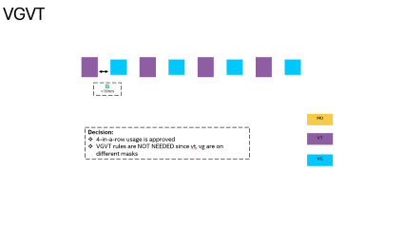
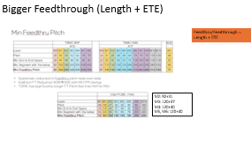
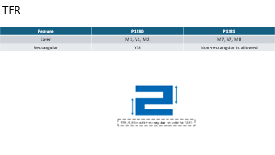
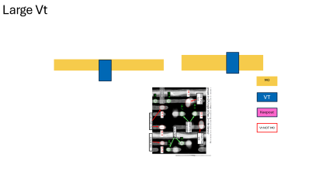
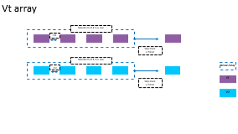
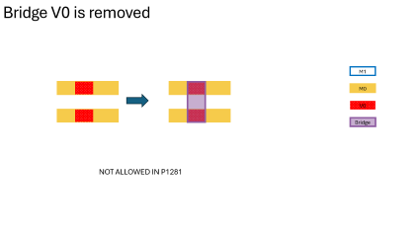
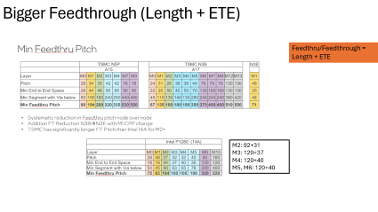
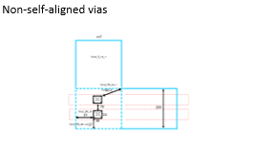

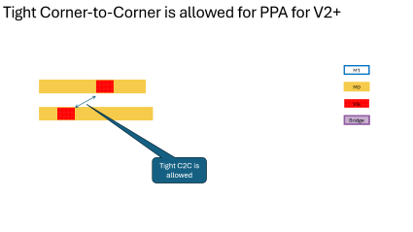
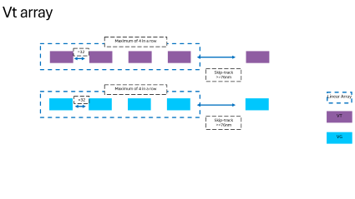


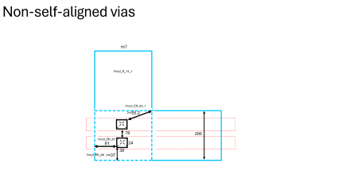
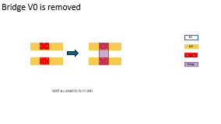

High-Level Changes in P1281
List:
Via size offerings are reduced
Large VT is offered with edge-alignment for performance
TFR is between M7-M8 (P1280 is between M1-M2)
Self-aligned vias are removed for V6+
Long vt, vg array is removed (must be <=4)
M0, M2 allows flexible rules (depop)
Tight Corner-to-Corner is allowed for PPA for V2+
Bigger feedthrough (Length + ETE ) for M2+
Bridge V0 is not allowed

Slide 35
High Stack level changes with respect to P1280
Layer | X81RB (opt97, RECL) | X81Z (opt97) | X81A (opt97) | PPA-ONLY (opt99)
PP | 44p | 44p | 44p | 44p
M0 | 21p | 21p | 21p | 21p
M1 | 44p | 44p | 44p | 44p
M2 | 24p | 24p | 24p | 24p
M# | 33p (M3) | GVA (TSDR) | 33p (M3) | 33p (M3)
M# | 33p (M4) | 3000p (M15) (SDR) | 33p (M4) | 33p (M4)
M# | 40p (M5) | Viabp (V15) (SDR) | 40p (M5) | 40p (M5)
M# | GVA (TSDR) | C4T (TSDR) | 40p (M6) | 40p (M6)
M# | 3000p (M15) (SDR) | NA | 76p (M7) | 76p (M7)
M# | Viabp (V15) (SDR) | NA | 76p (M8) | 76p (M8)
M# | C4T (TSDR) | NA | 76p (M9) | 76p (M9)
M# | NA | NA | 76p (M10) | 76p (M10)
M# | NA | NA | 120p (M11) | 76p (M11)
M# | NA | NA | 120p (M12) | 76p (M12)
M# | NA | NA | 760p (M13) | 76p (M13)
M# | NA | NA | 760p (M14) | 76p (M14)
M# | NA | NA | MIM3X | 120p (M15)
M# | NA | NA | 3000p (M15) | 120p (M16)
M# | NA | NA | Viabp (V15) | 760p (M17)
M# | NA | NA | Bumpp (C4B) | 760p (M18)
M# | NA | NA | NA | MIM3X
M# | NA | NA | NA | 3000p (M19)
Note:
Using M# convention for all metal layers instead of BM#, GM#
Modules
Pitch | Module
44p | NA
21p | NA
44p | NA
24p | NA
32p | Mxa
32p | Mxb
40p | Mxc
76p | Myl (M7)
76p | Mya
76p | Myk (M10+)
120p | Myb
760p | Mga
3000p | Mgb
Modular

Slide 36
X81A Metal Stack Info
Layer module | PD Min width/space | PD Min Width | PD Min Space | PD Min Pitch | PD Wire Widths
M0 b110h_44ppBaseRegionRegion.id + digital;id | 12/9 | 12 | 9 | 21 | 12, 17
M0 b132h_44ppBaseRegionRegion.id+ digital;id | 13/9 | 15 | 9 | 22 | 15, 27
M0 b165h_44ppBaseRegionRegion.id+ digital;id | 13/9 | 14 | 9 | 22 | 14, 15, 37
M0 Mixed rows (110+132, 132+165, 110+132) | 13/9 | 12 | 9 | 22 | 12, 14, 15, 17, 22, 27, 32, 37
M1 | 24/20 | 24 | 20 | 44 | 24, 34, 36, 44, 46, 48, 54, 60, 64
M2 b110h_44ppBaseRegionRegion.id+ digital;id | 13/11 | 13 | 11 | 24 | 13, 27
M2 b132h_44ppBaseRegionRegion.id+ digital;id | 14/11 | 14 | 11 | 25 | 14, 21
M2 b165h_44ppBaseRegionRegion.id+ digital;id | 15/11 | 19 | 11 | 26 | 19, 33
M2 Mixed rows (110+132, 132+165, 110+132) | 15/11 | 13 | 11 | 26 | 13, 14, 19, 21, 24, 27, 30, 33
Mxa (M3) | 18/15 | 18 | 15 | 33 | 18, 20, 24, 36, 48, 60
Mxb (M4) | 18/15 | 18 | 15 | 33 | 18, 20, 24, 36, 48, 60
Mxc (M5) | 24/16 | 24 | 16 | 40 | 24, 36, 48, 60
Myl (M6) | 38/38 | 38 | 38 | 76 | 38, 40, 42, 44, 46, 48, 54, 60, 80, 120, 160, 200, 320, 440, 560, 680, 800, 920, 1040
Mya (M7+) | 38/38 | 38 | 38 | 76 | 38, 40, 42, 44, 46, 48, 54, 60, 80, 120, 160, 200, 320, 440, 560, 680, 800, 920, 1040
Myb | 60/60 | 60 | 60 | 120 | 60, 90, 120, 160, 200, 240, 320, 440, 560, 680, 800, 920, 1040
Mga | 380/380 | 380 | 380 | 760 | 380nm-6um
Mgb | 1500/1500 | 1500 | 1500 | 3000 | 1.5um-17um

Slide 37
Vt array
Maximum of 4 in a row
=32
Skip-track
>=76nm
Maximum of 4 in a row
=32
Linear Array
VT
Skip-track
>=76nm
VG

Slide 38
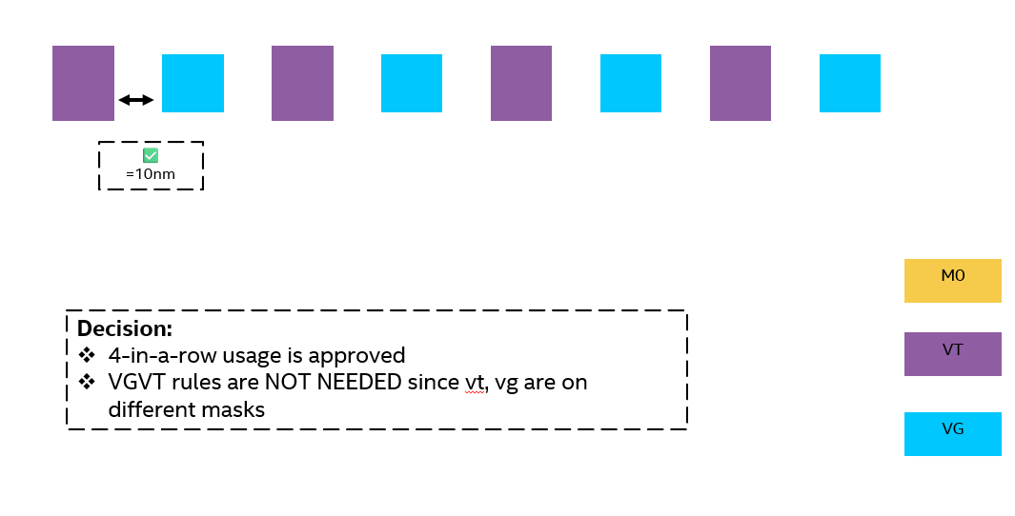
VGVT

Slide 39
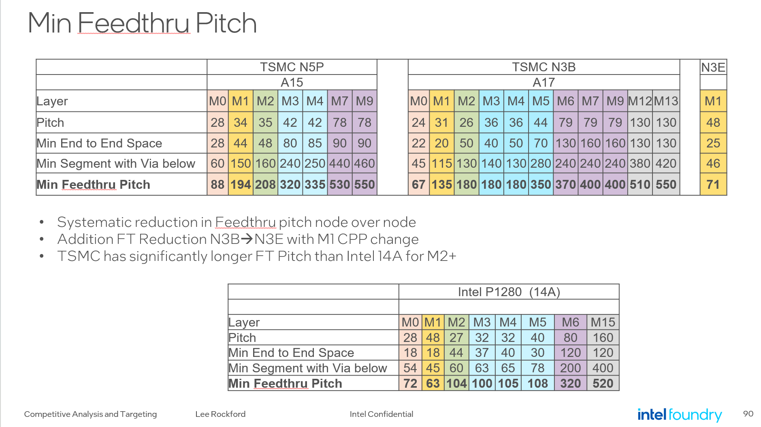
Bigger Feedthrough (Length + ETE)
Feedthru/Feedthrough = Length + ETE
M2: 92+31
M3: 120+37
M4: 120+40
M5, M6: 120+40

Slide 40
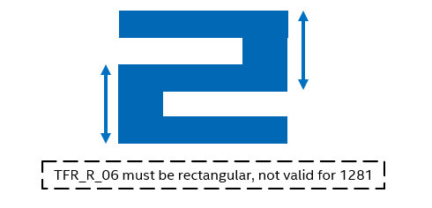
TFR
Feature | P1280 | P1281
Layer | M1, V1, M2 | M7, V7, M8
Rectangular | YES | Non-rectangular is allowed

Slide 41
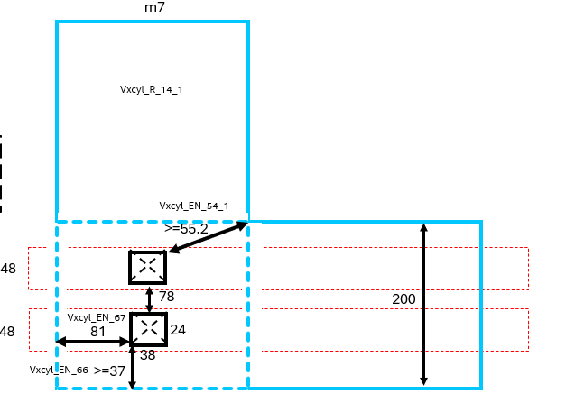
Non-self-aligned vias

Slide 42
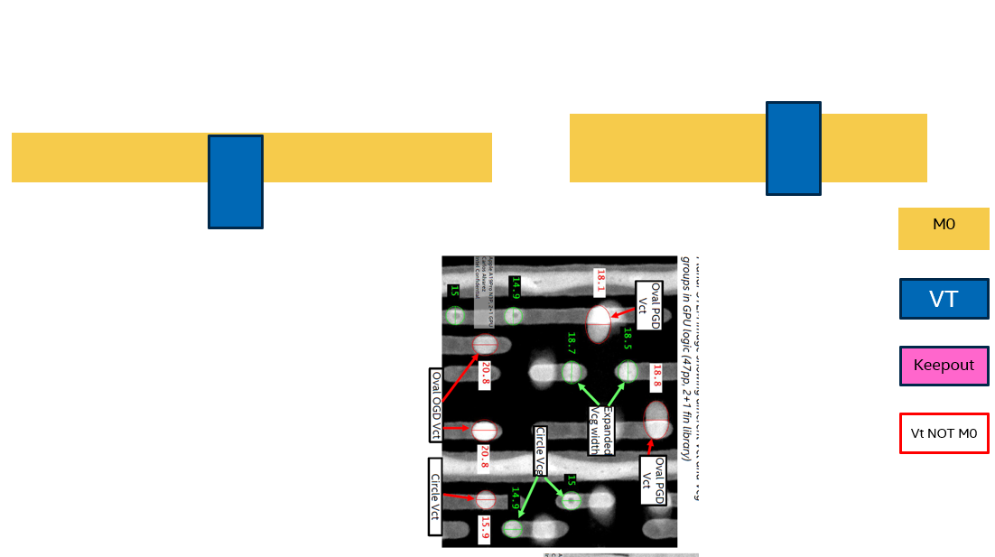
Large Vt

Slide 43
Bridge V0 is removed
M1
M0
V0
Bridge
NOT ALLOWED IN P1281

Slide 44
Tight Corner-to-Corner is allowed for PPA for V2+
M1
M0
Via
Bridge
Tight C2C is allowed

Slide 45
TBD

Slide 46
Vt, Vg
Layer | Feature | P1280 Reference | Working Assumption
Vt | Metal Transition | 48-27 | 44-21
Vt | Sizes | 6 sizes | 4-5 sizes
Vt | PGD Space | >=40nm | >=30nm if PGD width <=15 >=35nm if PGD width >15
Vt | OGD Space | >=82nm Exception: >=34 for via <=20nm | >=76nm Exception: >=32 for full-facing
Vt | C2C Space | >=35.5nm | >=38 (general rule) >=33.2 if PGD width <=15 + some select use-cases
Vt | Consecutive via rules | OGD: <=6 (adjacent vt) Exception: <=130 memory or custom | OGD: <=4 (adjacent vt)
Vt | Enclosure (tcn) | >=0 (must be inside) | >=0.5nm with more details per via type
Vt | Enclosure (Mx+1) | General: >=17nm MinpitchID >=8nm (if < 20nm) | >=5nm, >=7nm, >=16nm
vt | {TRM} handling | PGD space: >=54nm PGD space to another vt: >=47nm PGD space to mergedm0_vt: >=20nm | ALLOWED with no restrictions
vt | Large VT handling | NA | Keepout zone: 18/38 (PGD/OGD) PGD space: >=35nm C2C space: >=38nm
vt | Centering with Mx and Mx+1 | YES | edge aligned (away from CRL/DKA) or center aligned
Vt | vt | YES | Consecutive two Vias space: >=33nm in PGD (allows adjacent track for 132h and 165h)

Slide 47
Vt, Vg
Layer | Feature | P1280 Reference | Working Assumption
Vg | Metal Transition | 48-27 | 44-21
Vg | Sizes | 4 sizes | Limit sizes
Vg | PGD Space | >=40nm | >=32nm if PGD width <=15 >=35nm if PGD width >15 (this is likely not needed)
Vg | OGD Space | >=34nm | >=76nm Exception: >=32 for full-facing
Vg | C2C Space | >=35.5nm | >=33.2nm
Vg | Consecutive via rules | OGD: <=16 (adjacent vg) Exception: <=260 memory or custom | OGD: <=4 (adjacent vg)
Vg | Enclosure (poly) | <=2.5nm (extension) | <=0.5nm (extension, i.e., unlanded vias)
Vg | Enclosure (Mx+1) | General: >=17nm MinpitchID: >=8nm (<=19nm) | >=5nm, >=7nm, >=16nm
Vg | {TRM} handling | PGD space: >=54nm PGD space to another vt: >=47nm PGD space to mergedm0_vt: >=20nm | PGD space: 69.5nm
vg | Centering with Mx and Mx+1 | YES | edge aligned or center aligned
Vg | Vgvt pair | YES (10nm space and same size) NOT allowed in m0Minpitch;id | YES with no new restrictions
Vg | Vg patterns | YES | Consecutive two Vias space: >=32.8nm in PGD (allows adjacent track for 132h and 165h)

Slide 48
M0 Rules
Layer | Feature | P1280 Reference | Working Assumption
M0 | Pitch (W/S) | SALELE: 14W/13S | SALELE: 12W/9S
M0 | Length | SALELE: >=54nm (small ETE), >=78nm (large ETE) LELE: >=78nm (small ETE), >=102nm (unrestricted) PGD: >=160nm | 48, >=66, 70, >=88
M0 | ETE | SALELE: Color1: ==18nm, Color2: >=18nm (<20nm), >=42nm (>=20nm) <=114nm (2pp) for color2 LELE: >=66nm | >=18, >=22, >=44, >=66nm <=106nm (no maximum ETE)
M0 | Attacker | PGD-OGD: >=66nm, >=35nm, >=30nm OGD-PGD: >=63nm | No M0 PGD support
M0 | PRL/Offset | Gridding with respect to poly or tcn track | Gridding with respect to poly or tcn track
M0 | Max Space | <=153nm in OGD, <=165nm in PGD | <=4*44p in OGD and <=3 wires at 21p in PGD
M0 | Color 1 ETE space in PGD | 18nm ETE to 42nm ETE: >=52nm 42nm ETE to 42nm ETE: >=48nm | 18nm ETE to 18nm ETE: >=30nm is not needed Only double is allowed at ==30nm space Unrestricted space >=32.8 (based on 165nm use case)

Slide 49
M0 ETE, Length
M0 | PATTERN | Plug | Width Range | Widths | ETE | Length
Color1 | SALELE | YES==18 | <=15 | 12, 13,14, 14.8, 15 | ==18nm (full-facing), >=62nm | >=48nm with TWO ETEs of ==18nm ETE >=70nm with ONE ETEs of ==18nm ETE
Color1 | SALELE/LELE | YES==22 | >15 and <=20 | 17, 20 | =22nm (full-facing), >=44nm (full-facing), >=62nm | >=88nm with TWO ETEs of ==22nm ETE >=88nm with ONE ETEs of ==22nm ETE
Color1 | SALELE/LELE | NO | >20 | 22, 24, 27 | >=44 (full-facing), >=62nm | >=92nm
Color2 | SALELE | NO | <=15 | 12, 13, 14, 14.8, 15 | >=18nm (full-facing) | >=48nm with ONE ETEs of ==18nm ETE >=70nm
Color2 | SALELE | NO | >15 and <=24 | 17, 20, 22, 24 | >=22nm (full-facing) | >=66nm with ONE ETEs of ==18nm ETE >=70nm
Color2 | LELE | NO | >24 | 27, 32, 37 | >=44 (full-facing), >=62nm | >=88nm

Slide 50
V0 Rules
Layer | Feature | P1280 Reference | Working Assumption
V0 | Metal Transition | 27-48 | 21-44
V0 | Sizes | 16 sizes | Limit the via size to 4-6 vias
V0 | PGD Space | >=40nm Exception: 13nm to enable bridge via | >=42nm as general rule Exception: >=30nm No bridge via enablement
V0 | OGD Space | 46nm (1.5pp-26nm) Exception: 22nm for small vias (adjacent) | <=42nm (1.5pp-24) Exception: 20nm for small vias (PGD width <=15)
V0 | C2C Space | 42nm Exception: 25.5nm for small vias (<=19nm) | >=29nm Exception: 21.9nm
V0 | Consecutive via rules | OGD: Max of 2 vias PGD: No rules C2C: No rules | OGD: Max of 2 vias PGD: No rules C2C: No rules
V0 | Enclosure (Mx) | >=26nm on M0 OGD wire Exception: 2nm for small wires Not allowed on M0 PGD wire | >=23nm on M0 OGD wire (fit M0 ETE within M1 skip-track) Exception: 1nm for small vias (Library must-have) Not allowed on M0 PGD wire
V0 | Enclosure (Mx+1) | 11nm on M1 PGD wire 20nm on M1 OGD wire | 12.5nm is general use 6nm on M1 PGD wire (library) 20nm on M1 OGD wire if M1 OGD is allowed

Slide 51
M1 Rules
Layer | Feature | P1280 Reference | Working Assumption
M1 | Pitch (W/S) | 26W/22S | 24W/20S
M1 | Length | >=45nm for PGD >=126nm for OGD | >=37nm for PGD. Brickwall rules are added >=126nm for OGD if OGD is available
M1 | ETE | >=35nm as general rule >=18nm for <=26nm PGD wires >=40nm for OGD wires | >=35nm as general rule >=18nm for 24nm wires
M1 | Attacker | PGD-OGD: >=35nm OGD-PGD: >=45nm | PGD-OGD: >=35nm OGD-PGD: >=45nm
M1 | PRL/Offset | PRL: >=9nm if space <=33 for PGD wires, >=30nm if space <=45nm for OGD wires Offset: >=7nm if space <=33 for PGD wires, >=30nm if space <=45nm for OGD wires | REMOVED PRL/OFFSET FOR PGD WIRES PRL: >=3nm if space <=33 for PGD wires, >=30nm if space <=45nm for OGD wires Offset: >=7nm if space <=33 for PGD wires, >=30nm if space <=45nm for OGD wires
M1 | Max Space | <=184.5 in PGD, <=159.5nm in OGD | <=184.5 in PGD, <=159.5nm in OGD

Slide 52
V1 Rules
Layer | Feature | P1280 Reference | Working Assumption
V1 | Metal Transition | 48-27 | 44-24
V1 | Sizes | 10 sizes | Limit the via size to 4-6 vias
V1 | PGD Space | >=44nm (b126h) >=40.5 for fuse >=40nm for 26x14 (b108h) | General rule:>=42.5nm (based on 165h) Exception: >=35nm for small vias
V1 | OGD Space | >=46nm (custom, based on 1.5pp) (1.5*48-26) | >=42nm (custom, based on 1.5pp) (1.5*48-26)
V1 | C2C Space | >=42nm Exception: 25.5nm for small vias (adjacent) | >=40.3nm (skip-track) Exception: 22.8nm for small vias
V1 | Consecutive via rules | OGD: Max of 2 vias within 67nm C2C: Max of 2 or 3 vias within 42nm | OGD: Max of 2 vias C2C: Max of 3 vias PGD: Max of 3 vias C-shape needs new restrictions
V1 | Enclosure (Mx) | 9nm on M1 PGD wire 20nm on M1 OGD wire | 9nm as general rule Exception: 2.5nm/1.5nm on M1 PGD wire 20nm on M1 OGD wire
V1 | Enclosure (Mx+1) | 13nm on M2 OGD wire 20nm on M2 PGD wire | General >= 19nm If m2 ETE == 40nm and V1-V1 at skip-track, v1m2 = 12nm X81A will get a waiver per integration tem.

Slide 53
M2 Rules
Layer | Feature | P1280 Reference | Working Assumption
M2 | Pitch (W/S) | 14W/13S | 110h: 24p (13W/11S) Powerline: 27nm
M2 | Length | >=60nm (with 2.2pp for feedthrough) | 3pp feedthrough assumption >=92nm
M2 | ETE | >=44nm <=148nm full-facing for both colors (with 2.2pp for feedthrough) >=66nm not full-facing for both colors | >=66nm (color1), >=44nm (color2) as general rules >=40nm (color1), >=31nm (color2) for full-facing No max ETE rules
M2 | Attacker | >=66nm | NO attacker is needed
M2 | PRL/Offset | PRL: >=4nm if space <=32 Offset: >=48nm if space <=32 | Gridding with respect to poly or tcn track
M2 | Max Space | <=153nm in OGD, <=165nm in PGD | In OGD: 4*pp In PGD: 3 skip track

Slide 54
M2 Rules
Feature | POR P1280 | P1281 starting point
M2 Min Length + ETE | 2.2PP | 2.2PP → 3PP
M2 Min length | 60 | 56 → 92nm
M2 ETE | 44 | 40
V1M2 Enclosure | 13 | 12
V2M2 Enclosure | 17 | 17
PRL/Offset | PRL: >=4nm if space <=32 Offset: >=48nm if space <=32 | NA

Slide 55
V2 Rules
Layer | Feature | P1280 Reference | Working Assumption
V2 | Metal Transition | 27-32 (Vm2xa) | 24-32 (Vm2xa)
V2 | Sizes | 13 sizes | Limit the via size to 4-6 vias
V2 | PGD Space | >=44nm Exception: >=42nm for memory columnID Exception: >=40nm for 18x14 | >=42.5nm (160h) >=35nm (skip-track) (b110h) Skip-track enablement for other cell heights
V2 | OGD Space | >=46nm | >=48nm
V2 | C2C Space | >=45nm | >=38nm >=18.6nm for small via (no c-shape or v-shape, up to 3-in-a-row)
V2 | Consecutive via rules | PGD: Max of 2 vias | PGD: Max of 2 vias Allowance for MFC-like structures (added as general rule)
V2 | Enclosure (Mx) | 17nm on M2 OGD wire 17nm on M2 PGD wire | 19.5nm on M2 OGD wire 17nm on M2 PGD wire
V2 | Enclosure (Mx+1) | 19nm on M3 PGD wire >=21.5nm on M3 PGD wire width <=20 19nm on M3 OGD wire | 19nm on M3 PGD wire >=21.5nm on M3 PGD wire width <=20 19nm on M3 OGD wire
V2 | Density | <=15% (10x10um) | <=15% (10x10um)
V2 | V1-V2 min spacing | NA | >11 if PRL >10
V2 | Triplet rules | NA | OGD: >=48nn PGD: >=35nm, >=40nm C2C: >=38nm

Slide 56
M3 Rules
Layer | Feature | P1280 Reference | Working Assumption
M3 | Pitch (W/S) | 18W/14S (Mxa) | 18W/14S (Mxa)
M3 | Length | >=63nm in PD or NPD >=76nm for <24nm | >=120 in PD and NPD
M3 | ETE | >=37nm in PD (>=32nm for wires <=20nm) >=40nm in NPD | >=37nm in PD >=40nm in NPD
M3 | Attacker | PGD-OGD: >=45nm OGD-PGD: >=40nm | PGD-OGD: >=45nm OGD-PGD: >=40nm
M3 | PRL/Offset | PRL: >=14nm if space <=32 for PGD wires, >=30nm if space <=51 for OGD wires Offset: >=25nm if space <=32 for PGD wires, >=30nm if space <=51 for OGD wires | PRL: >=14nm if space <=32 for PGD wires, >=30nm if space <=51 for OGD wires Offset: >=25nm if space <=32 for PGD wires, >=30nm if space <=51 for OGD wires
M3 | Max Space | <=349.5nm in PGD <=134.5nm in OGD | <=349.5nm in PGD <=134.5nm in OGD

Slide 57
V3 Rules
Layer | Feature | P1280 Reference | Working Assumption
V3 | Metal Transition | 32-32 (Vxaxb) | 32-32 (Vxaxb)
V3 | Sizes | 10 sizes | Limit the via size to 4-6 vias
V3 | PGD Space | >=46nm (1 skip M3 track) | >=48nm (1 skip M3 track)
V3 | OGD Space | >=46nm (1 skip M4 track) | >=48nm (1 skip M4 track)
V3 | C2C Space | >=42nm >=55nm (for V3_26x26), 60nm (for V3_18x48, V3_24x36) | >=42nm >=55nm (for V3_26x26), 60nm (for V3_18x48, V3_24x36) >=21.2nm for small via (no c-shape or v-shape, up to 3-in-a-row)
V3 | Consecutive via rules | OGD: Max of 3 vias within <=67nm | OGD: Max of 3 vias within <=67nm Allowance for MFC-like structures (added as general rule)
V3 | Enclosure (Mx) | >=19nm (fit single ETE of 37nm in space of 75nm between 18nm and 24nm wire) | >=19nm (fit single ETE of 37nm in space of 75nm between 18nm and 24nm wire)
V3 | Enclosure (Mx+1) | >=19nm (fit single ETE of 37nm in space of 75nm between 18nm and 24nm wire) | >=19nm (fit single ETE of 37nm in space of 75nm between 18nm and 24nm wire)

Slide 58
M4 Rules
Layer | Feature | P1280 Reference | Working Assumption
M4 | Pitch (W/S) | 18W/14S (Mxb) | 18W/14S (Mxb)
M4 | Length | >=65nm in PD or NPD >=80nm for <24nm | >=120nm in PD or NPD
M4 | ETE | >=40nm in PD >=40nm in NPD | >=40nm in PD >=40nm in NPD
M4 | Attacker | PGD-OGD: >=40nm OGD-PGD: >=45nm | PGD-OGD: >=40nm OGD-PGD: >=45nm
M4 | PRL/Offset | PRL: >=17nm if space <=32 for OGD wires, >=30nm if space <=51 for PGD wires Offset: >=25nm if space <=32 for OGD wires, >=30nm if space <=51 for PGD wires | PRL: >=17nm if space <=32 for OGD wires, >=30nm if space <=51 for PGD wires Offset: >=25nm if space <=32 for OGD wires, >=30nm if space <=51 for PGD wires
M4 | Max Space | <=349.5nm in OGD <=134.5nm in PGD | <=349.5nm in PGD <=134.5nm in PGD

Slide 59
V4 Rules
Layer | Feature | P1280 Reference | Working Assumption
V4 | Metal Transition | 32-40 (Vxbxc) | 32-40 (Vxbxc)
V4 | Sizes | 7 sizes | Limit the via size to 4-6 vias
V4 | PGD Space | >=44nm | >=48nm
V4 | OGD Space | >=54nm | >=56nm
V4 | C2C Space | >=42nm | >=48nm >=21nm for small via (no c-shape or v-shape, up to 3-in-a-row)
V4 | Consecutive via rules | PGD: Max of 3 vias within <=55nm | PGD: Max of 3 vias within <=67nm (Vxbxc_R_292_2) Allowance for MFC-like structures (added as general rule)
V4 | Enclosure (Mx) | >=19nm | >=19nm
V4 | Enclosure (Mx+1) | >=19nm | >=19nm
V4 | Density | <=15% (10x10um) | tighter values

Slide 60
M5-M6 Rules
Layer | Feature | P1280 Reference | Working Assumption
M5 | Pitch (W/S) | 24W/16S (Mxc) | 24W/16S (Mxc)
M5 | Length | >=78nm in PD or NPD | >=120nm in PD or NPD
M5 | ETE | >=30nm in PD >=40nm in NPD | >=40nm in PD >=40nm in NPD
M5 | Attacker | PGD-OGD: >=40nm OGD-PGD: >=40nm | PD-NPD: >=45nm NPD-PD: >=40nm
M5 | PRL/Offset | PRL: >=30nm if space <=22.5nm for PD wires, >=30nm if space <=22.5nm for NPD wires Offset: >=30nm if space <=51 for PD wires, >=30nm if space <=51 for NPD wires | PRL: >=30nm if space <=22.5nm for PD wires, >=30nm if space <=22.5nm for NPD wires Offset: >=30nm if space <=51 for PD wires, >=30nm if space <=51 for NPD wires
M5 | Max Space | <=239.5nm in PD <=147nm in NPD | <=239.5nm in PD <=147nm in NPD

Slide 61
V5 Rules
Layer | Feature | P1280 Reference | Working Assumption
V5 | Metal Transition | 32-32 (Vxaxb) | 40-40 (Vxc)
V5 | Sizes | 10 sizes | Limit the via size to 4-6 vias
V5 | PGD Space | >=46nm (1 skip M3 track) | >=56nm (1 skip M5 track)
V5 | OGD Space | >=46nm (1 skip M4 track) | >=56nm (1 skip M6 track)
V5 | C2C Space | >=42nm >=55nm (for V3_26x26), 60nm (for V3_18x48, V3_24x36) | >=58.2nm >=22.6nm small via(no c-shape or v-shape, only 3-in-a-row) 60nm (24x36)
V5 | Consecutive via rules | OGD: Max of 3 vias within <=67nm | OGD: Max of 3 vias within <=67nm Allowance for MFC-like structures (added as general rule)
V5 | Enclosure (Mx) | >=19nm (fit single ETE of 37nm in space of 75nm between 18nm and 24nm wire) | >=19nm
V5 | Enclosure (Mx+1) | >=19nm (fit single ETE of 37nm in space of 75nm between 18nm and 24nm wire) | >=19nm
V5 | Density | <=15% (10x10um) | <=15% (10x10um)

Slide 62
V6_Vxcyl Rules
Layer | Feature | P1280 Reference | Working Assumption
V6 | Metal Transition | 40-80 (v5_Vxcyl) | 40-76 (v6_Vxcyl)
V6 | Via Type | SA and NSA | NSA only
V6 | Sizes | 8 sizes | Limit the via size to 5 vias
V6 | PGD Space | >=120nm (1 skip Myl track) | >=90nm (1 skip Mxc track)
V6 | OGD Space | >=88nm (1 skip Mxc track) | >=90nm (1 skip Myl track)
V6 | C2C Space | >=96.5nm | >=80nm
V6 | Consecutive via rules | OGD: Max of 3 vias within <96nm | No limit to number of vias spaced at >=90nm in OGD, PGD
V6 | Enclosure (Mx) | >=24nm | >=24nm
V6 | Enclosure (Mx+1) | >=48nm | >=60nm
V6 | Density | <=15% (10x10um) | <=15% (10x10um)

Slide 63
M7_Myl Rules
Layer | Feature | P1280 Reference | Working Assumption
Myl | Pitch (W/S) | 40W/40S (Myl) | 38W/38S (Myl)
Myl | Length | >=200nm in PD or NPD | >=240nm in PD or NPD
Myl | ETE | >=120nm in PD and NPD | ==120nm, >=180 in PD and NPD
Myl | Attacker | PD-NPD: >=160nm, >=120nm (fat wires) NPD-PD: >=180nm | PD-NPD: >=180nm, >=240nm (fat wires) NPD-PD: >=180nm
Myl | PRL/Offset | NA | PRL >=120, offset >=240 with exceptions
Myl | Density | >=19.5%, <=60% (50um window) | >=15%, <=70% (20um window)
Myl | Density Gradient | <=30% (50um window) | <=30% (20um window)
Myl | Max Space | <=670.5nm in PD <=389.5nm in NPD | <=670.5nm in PD <=389.5nm in NPD

Slide 64
V7_Vylya Rules
Layer | Feature | P1280 Reference | Working Assumption
V7 | Metal Transition | 80-80 (Vylya) | 76-76 (Vylya)
V7 | Via Type | SA and NSA | NSA only
V7 | Sizes | 12 sizes | Limit the via size to 5 vias
V7 | PGD Space | >=65nm | >=75nm (1 skip Mya track)
V7 | OGD Space | >=65nm | >=75nm (1 skip Myl track)
V7 | C2C Space | >=120nm | >=58nm
V7 | Consecutive via rules | OGD: Max of 3 vias within <120nm | No limit to number of vias spaced at >=75nm in OGD, PGD
V7 | Enclosure (Mx) | >=50nm | >=50nm
V7 | Enclosure (Mx+1) | >=60nm | >=60nm
V7 | Density | <=15% (10x10um) | <=10% (100x100um)

Slide 65
M8-M10 Mya Rules
Layer | Feature | P1280 Reference | Working Assumption
Mya | Pitch (W/S) | 40W/40S (Mya) | 38W/38S (Mya)
Mya | Length | >=200nm in PD or NPD | >=240nm in PD or NPD
Mya | ETE | >=120nm in PD and NPD | ==120nm, >=180 in PD and NPD
Mya | Attacker | PD-NPD: >=160nm, >=120nm (fat wires) NPD-PD: >=180nm | PD-NPD: >=180nm, >=240nm (fat wires) NPD-PD: >=180nm
Mya | PRL/Offset | NA | PRL >=120, offset >=240 with exceptions
Mya | Density | >=19.5%, <=60% (50um window) | >=15%, <=70% (20um window)
Mya | Density Gradient | <=30% (50um window) | <=30% (20um window)
Mya | Max Space | <=670.5nm in PD <=389.5nm in NPD | <=670.5nm in PD <=389.5nm in NPD

Slide 66
V8-V9 Vya Rules
Layer | Feature | P1280 Reference | Working Assumption
V7 | Metal Transition | 80-80 (Vylya) | 76-76 (Vylya)
V7 | Via Type | SA and NSA | NSA only
V7 | Sizes | 12 sizes | Limit the via size to 5 vias
V7 | PGD Space | >=65nm | >=75nm (1 skip Mya track)
V7 | OGD Space | >=65nm | >=75nm (1 skip Myl track)
V7 | C2C Space | >=120nm | >=58nm
V7 | Consecutive via rules | OGD: Max of 3 vias within <120nm | No limit to number of vias spaced at >=75nm in OGD, PGD
V7 | Enclosure (Mx) | >=50nm | >=50nm
V7 | Enclosure (Mx+1) | >=60nm | >=60nm
V7 | Density | <=10% (100x100um) | <=10% (100x100um)

Slide 67
V10 Vyayb Rules
Layer | Feature | P1280 Reference | Working Assumption
Vyayb | Metal Transition | 80-120 (Vyayb) | 76-120 (Vyayb)
Vyayb | Via Type | SA and NSA | NSA only
Vyayb | Sizes | 12 sizes | Limit the via size to 1 via
Vyayb | PGD Space | >=65nm | >=60
Vyayb | OGD Space | >=65nm | >=60
Vyayb | C2C Space | >=120nm | >=55nm (same net), >=70 nm (different net)
Vyayb | Consecutive via rules | OGD: Max of 3 vias within <120nm | Limit to 8 vias spaced at >=60nm on same metal junction
Vyayb | Enclosure (Mx) | >=50nm | >=50nm
Vyayb | Enclosure (Mx+1) | >=38nm | >=38nm
Vyayb | Density | <=10% (100x100um) | <=10% (100x100um)

Slide 68
M11_Myb Rules
Layer | Feature | P1280 Reference | Working Assumption
Myb | Pitch (W/S) | 60W/60S (Myb) | 60W/60S (Myb) (copied from P1280.3)
Myb | Length | >=240nm in PD or NPD | >=240nm in PD or NPD
Myb | ETE | >=120nm in PD and NPD | >=120nm in PD and NPD
Myb | Attacker | PD-NPD: >=120nm NPD-PD: >=180nm (grow by 120nm in PD) | PD-NPD: >=120nm NPD-PD: >=180nm (grow by 120nm in PD)
Myb | PRL/Offset | NA | NA
Myb | Density | >=19.5%, <=60% (50um window) | >=10%, <=75% (50um window)
Myb | Density Gradient | <=30% (50um window) | <=35% (50um window)
Myb | Max Space | <=670.5nm in PD <=389.5nm in NPD | <=670.5nm in PD <=389.5nm in NPD

Slide 69
Vyb Rules
Layer | Feature | P1280 Reference | Working Assumption
Vyb | Metal Transition | 120-120 (Vyayb) | 120-120 (Vyayb)
Vyb | Via Type | SA and NSA | NSA only
Vyb | Sizes | 13 sizes | Limit the via size to 1 via
Vyb | PGD Space | >=60nm | >=60
Vyb | OGD Space | >=60nm | >=60
Vyb | C2C Space | >=120nm | >=55nm (same net), >=70 nm (different net)
Vyb | Consecutive via rules | OGD: Max of 3 vias within <120nm | Limit to 8 vias spaced at >=60nm on same metal junction
Vyb | Enclosure (Mx) | >=24nm | >=50nm
Vyb | Enclosure (Mx+1) | >=38nm | >=38nm
Vyb | Density | <=10% (100x100um) | <=10% (100x100um)

Slide 70
Vybga Rules
Layer | Feature | P1280 Reference | Working Assumption
Vybga | Metal Transition | 480-1080 (Vyfga) | 120-760 (Vybga)
Vybga | Via Type | NSA only | NSA only
Vybga | Sizes | 4 via sizes | Limit the via size to 1 via
Vybga | PGD Space | >=240nm | >=440nm, >=320nm on same net
Vybga | OGD Space | >=240nm | >=440nm, >=320nm on same net
Vybga | C2C Space | NA | No specific C2C DR, is controlled by PGD/OGD space rules
Vybga | Consecutive via rules | NA | No limit
Vybga | Enclosure (Mx) | >=120nm | >=120nm
Vybga | Enclosure (Mx+1) | >=54nm | >=120nm
Vybga | Density | <=24% (100x100um) | <=12% (100x100um)

Slide 71
Mga Rules
Layer | Feature | P1280 Reference | Working Assumption
Mga | Pitch (W/S) | 540W/540S (Mga) | 380W/380S (Mga)
Mga | Width min | >=540nm in PD and NPD | >=380nm in PD or NPD
Mga | Width max | <=6000nm in PD and NPD | <=6000nm in PD and NPD
Mga | Hole Area | >=2.2 sq um | >=1.1 sq um
Mga | Edge Length | >=540nm | >=200nm
Mga | Density | >=38%, <=90% 100um window) | >=40%, <=90% (100um window)
Mga | Density Gradient | <=35% (50um window) | <=25% (100um window)
Mga | Max Space | NA | NA

Slide 72
Vga Rules
Layer | Feature | P1280 Reference | Working Assumption
Vga | Metal Transition | 1080-1080 (Vga) | 760-760 (Vga)
Vga | Via Type | NSA only | NSA only
Vga | Sizes | 11 via sizes | Limit the via size to 1 via
Vga | PGD Space | >=530nm | >=440nm, >=320nm on same net
Vga | OGD Space | >=530nm | >=440nm, >=320nm on same net
Vga | C2C Space | NA | No specific C2C DR, is controlled by PGD/OGD space rules
Vga | Consecutive via rules | No limit | No limit
Vga | Enclosure (Mx) | >=100nm | >=120nm
Vga | Enclosure (Mx+1) | >=60nm | >=120nm
Vga | Density | <=12% (100x100um) | <=12% (100x100um)

Slide 73
Vgagb Rules
Layer | Feature | P1280 Reference | Working Assumption
Vgagb | Metal Transition | 1080-3000 (Vgagb) | 760-3000 (Vgagb)
Vgagb | Via Type | NSA only | NSA only
Vgagb | Sizes | Limit the via size to 5 via | Limit the via size to 5 via
Vgagb | PGD Space | >=2000nm | >=2000nm
Vgagb | OGD Space | >=2000nm | >=2000nm
Vgagb | C2C Space | >=2500nm | >=2500nm
Vgagb | Consecutive via rules | No limit | No limit
Vgagb | Enclosure (Mx) | >=140nm | >=140nm
Vgagb | Enclosure (Mx+1) | >=350nm | >=350nm
Vgagb | Density | <=12% (10x100um) | <=12% (100x100um)

Slide 74
Mgb Rules
Layer | Feature | P1280 Reference | Working Assumption
Mgb | Pitch (W/S) | 1500W/1500S (Mgb) | 1500W/1500S (Mgb)
Mgb | Width min | >=1500nm in PD and NPD | >=1500nm in PD or NPD
Mgb | Width max | <=17000nm in PD and NPD | <=17000nm in PD and NPD
Mgb | Hole Area | >=4.84 sq um | >=4.84 sq um
Mgb | Edge Length | >=540nm | >=540nm
Mgb | Density | >=38%, <=90% 100um window) | >=40%, <=90% (100um window)
Mgb | Density Gradient | <=25% (50um window) | <=25% (50um window)
Mgb | Max Space | NA | NA

